Slide 1
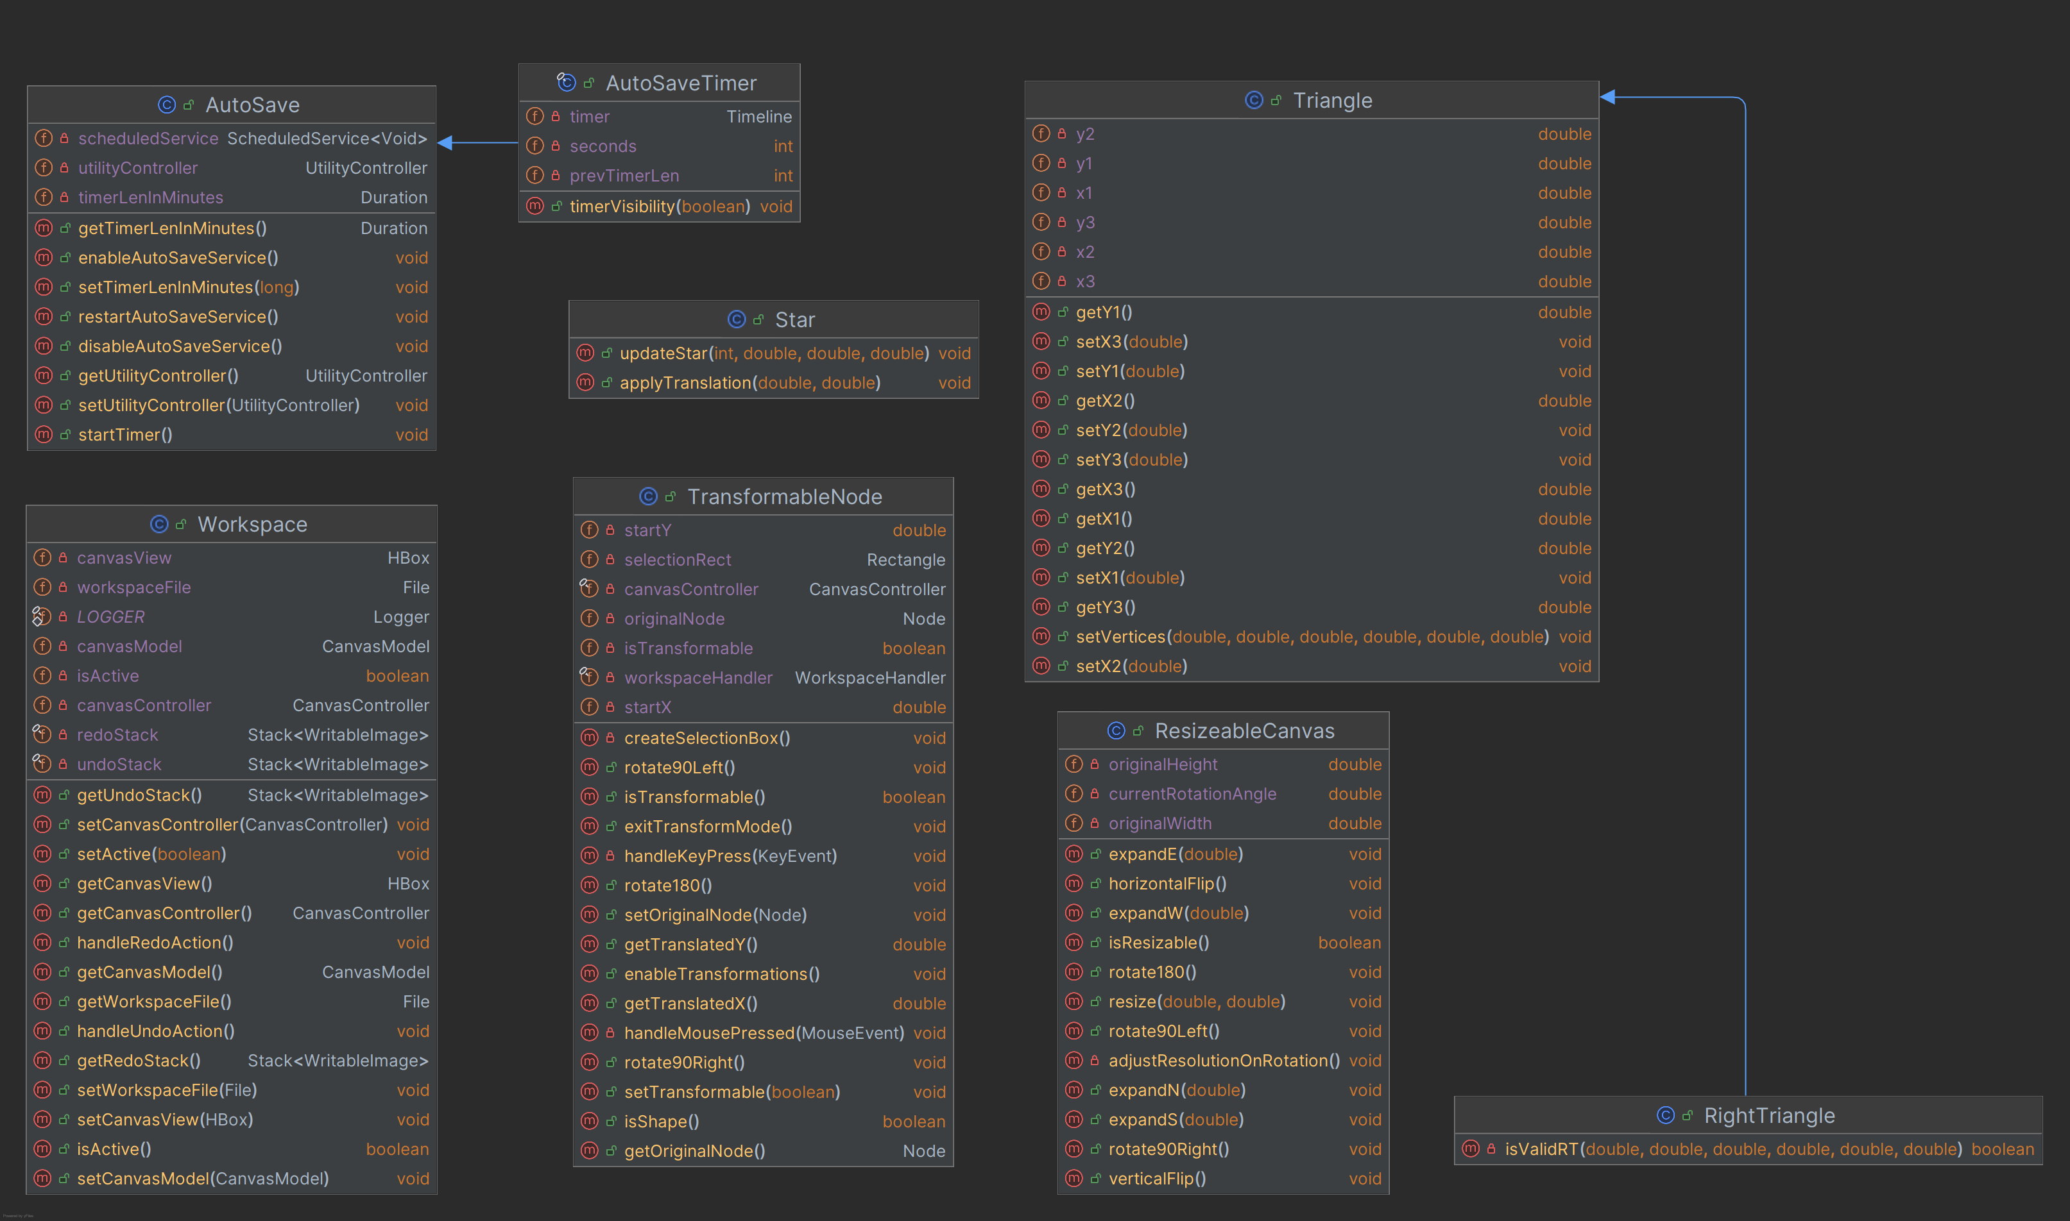
Class Diagram

Slide 2
Activity Diagram
Open File
Apply File Data to Canvas
[File Rejected]
[File Accepted]
Enable Drawing
Create New Tab

Slide 3
State Diagram
Mouse dragged on canvas [Mouse still on canvas] / Resize Node
Mouse leaves canvas
IDLE
Mouse pressed on canvas / capture start XY position
DRAWING NODE
[Mouse released] / Enter transformation state
NODE TRANSFORMATION STATE
/ Exit transformation state
Mouse pressed [Outside Node bounds]
APPLYING NODE TO CANVAS STATE
Mouse pressed [Inside Node bounds]
Mouse released
TRANSLATING NODE
Mouse dragged on canvas [Mouse inside Node bounds]

Slide 4


Use Case Diagram
Draw Shape
<<include>>
Select Shape Tool
Create New File
Adjust Line Width
<<include>>
Draw With Brush
Select Brush Tool
User
Save File
Show/Hide Auto-Save Timer
Open File
Enable/Disable Auto-Save
Open Auto-Save Settings
Adjust Auto-Save Interval

